Slide 1
A report to offer engineering solutions to reduce noise levels in Arada Kebab Restaurant
Tuna Dalbeler 21802539
ENG401-08

Slide 2
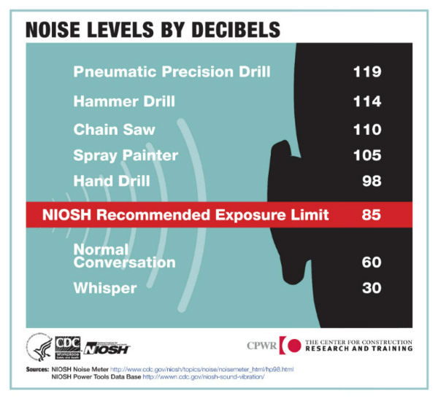
Intoduction
Zagat’s 2018 Dining Trends Survey of nearly 13,000 diners in the United States, the most irksome issue when it comes to dining out at was
noise (24%)
service (23%)
crowds (15%)
high prices (12%)
parking (10%) [2]
Figure 1: Noise Infographic by CDC [1]

Slide 3
Introduction
In a survey,
30% found their last dining experience too loud
24% regularly have to raise their voices to be heard
44% will choose a restaurant based on whether it is noisy or not
81% will not stay as long in a noisy restaurant
5% of responders suggested that they are more likely to use a takeaway than eat-in as the noise in restaurants has become uncomfortable [3]

Slide 4
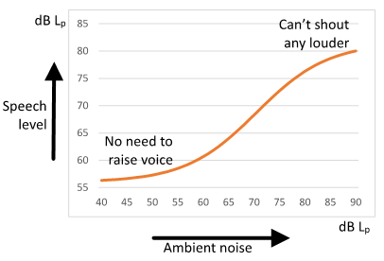
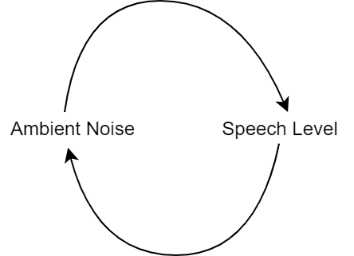
Lombard Effect
In a noisy environment people speaks louder. Which creates a noisier environment.
Figure 2: Lombard Effect [3]
Figure 3: Lombard Effect Causation Diagram

Slide 5
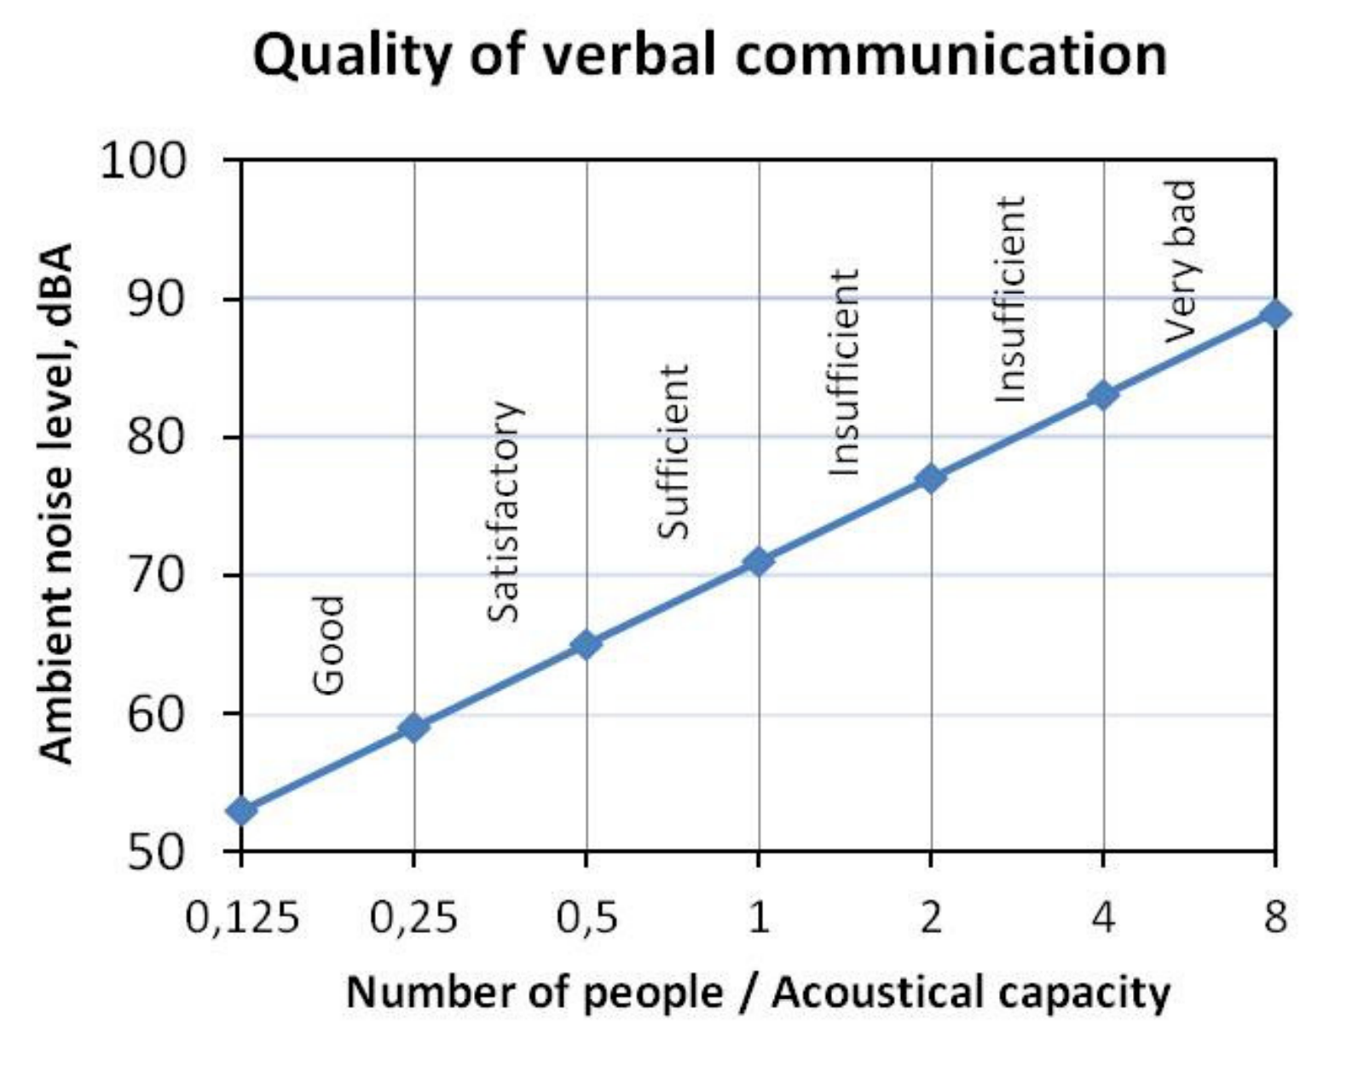
Reverberation Time
How long a sound stays in the room without fully absorbed (Simplified). One of the main contributors of ambiant noise.
Recomended «Acoustical Capacity» is calculated with
Volume and Reverberation Time[4]
Fig 4: Ambient noise level and quality of verbal communication as functions of the number of people relative to the Acoustical Capacity. [4]

Slide 6
Introduction
Purpose
Reduce the noise levels in Arada Kebab Restaurant.
Impact
Create a good environment for conservation quality.
Significance
Create a much more enjoyable dining experience in dining establishments.

Slide 7
Problem Definition
Study Area: Arada Ocakbaşı Bahçelievler (Kebab Restaurant)
Has 20 tables. Approx ~ 100 Person
Peak: 93 dB, Average: 78-82 dB
Problem: Too much ambiance (environmental) noice creates a low quality communucation for customers and staff.

Slide 8
Problem Definitition
Causes of the problem:
Reverberation time
Loud Music
Loud Air Conditioning Units

Slide 9
Proposed Solutions
1. Acoustically Absorbent Wall Panels and Flooring
2. Smart Music Control System
3. Quieter Air Conditioning Units

Slide 10
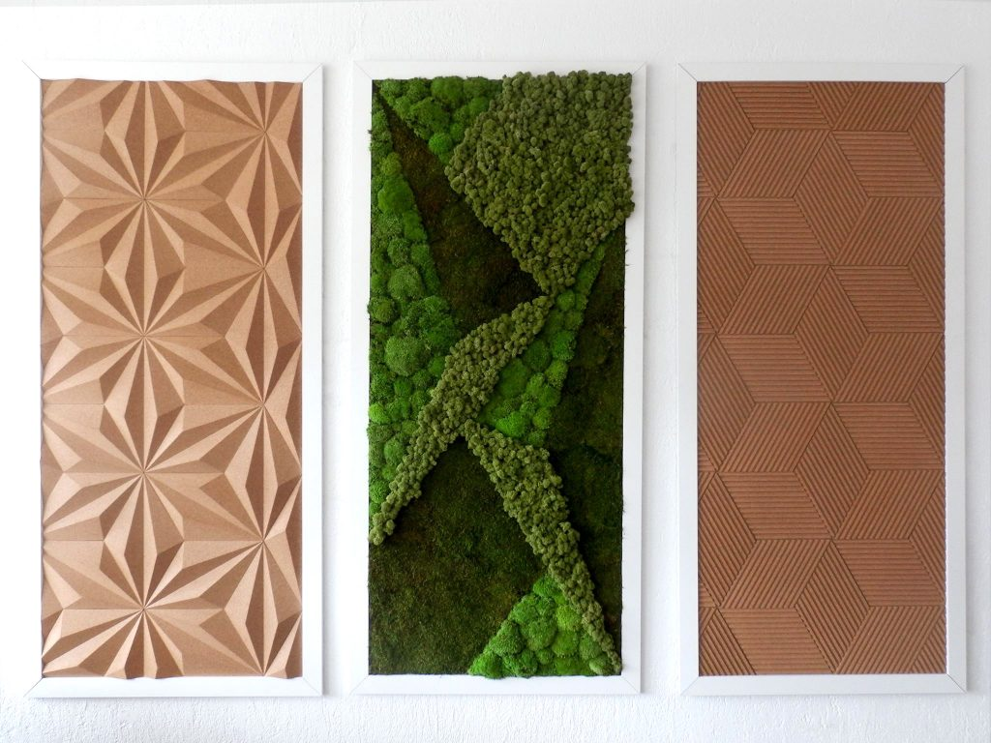
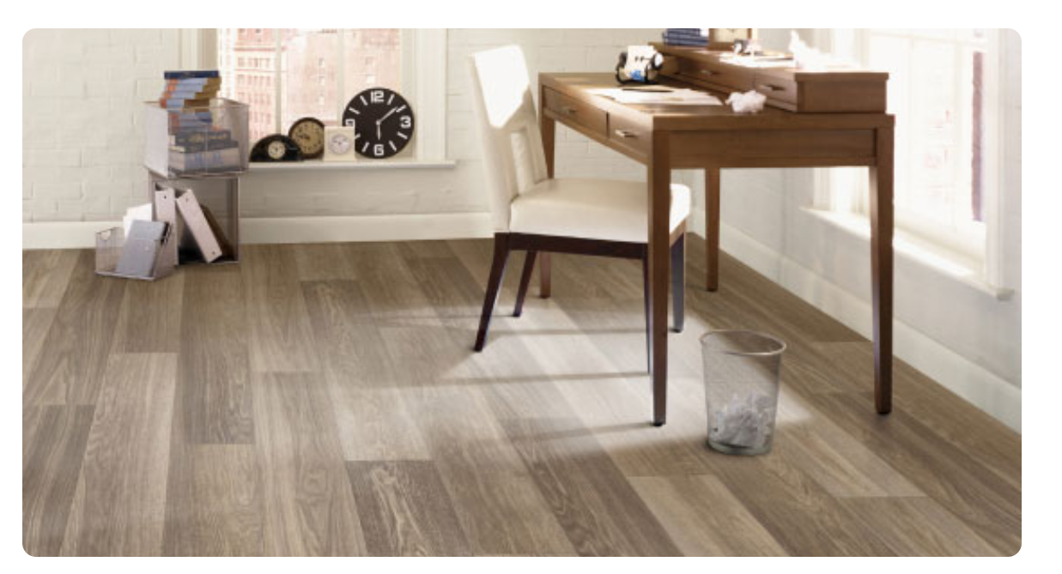
Acoustically Absorbent Wall Panels, Flooring
Aim: Reduced Reverberation Time
Flooring: Epoxy, Vinyl, Cork
Figure 5: Sound Panels Disguised [5]
Figure 6: Vinyl Flooring [6]

Slide 11
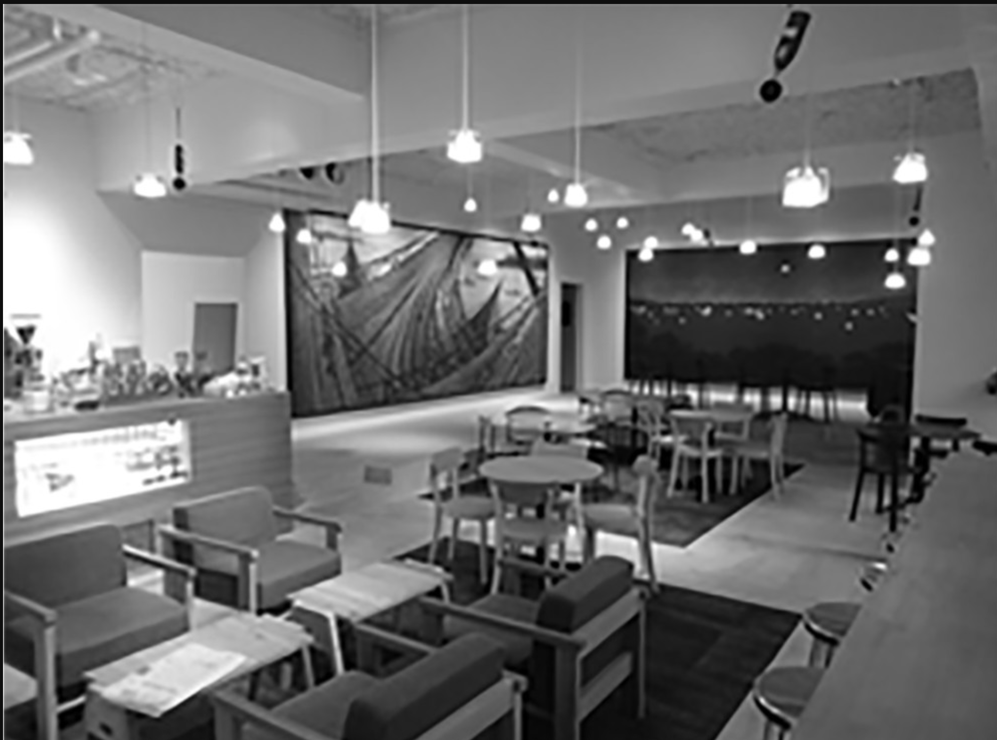
Smart Music Control System
Controls music sound level considering current loudness and customer count.
Microphones, proximity sensor and software
Why not turn it down completely?
Background music and background noise provides privacy. [6]
Figure 7: Installed Microphones in a dining area. [6]

Slide 12
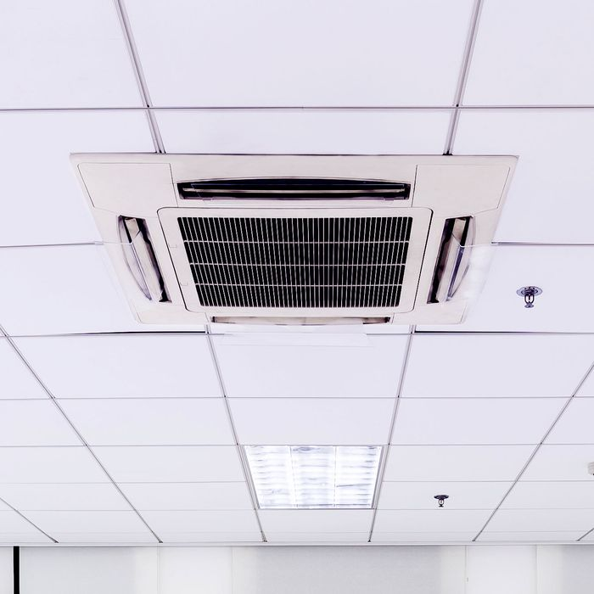
Quieter Air Conditioning Units
Currently the resaurant is equiped with very noisy fans, which are trying to take out smoke and other odors.
Also, has a loudly working huge two Air Conditioning units and one heater fan
in the service area.
Figure 7: Cassette AC Unit.[7]

Slide 13
Evaluation Criteria
Cost
Cost of the flooring and wall panels
Cost of the microphones, sensors and software
Cost of the Air Conditioning Units
Feasibility
The architectural permittable of new wall panels
The feasibility of installing microphones around the restaurant.
The architectural permittable of new AC units
Efficiency
The difference of reveb. time if walls and floor are applied.
The efficiency of the software to control music to reduce sound levels of environment.
The Difference between sound levels of old AC and new planned AC

Slide 14



Proposed Research Methodology
Experiments
Literature research
Market Search

Slide 15
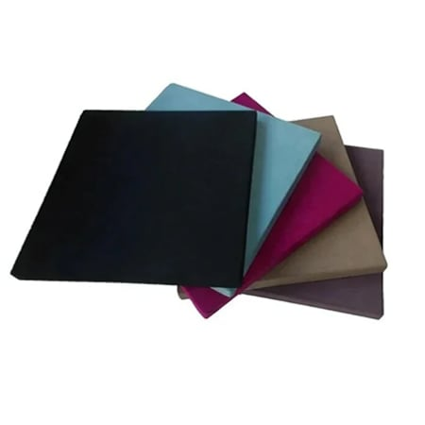
Cost - Wall Panels
Ege Acoustic: 3 cm thickness 50*50 cm sound absorbent panel. 166.7₺ per panel
NRC (Noise Reduction Coefficient) Value: 0.95 (Very Good Quality)[8]
Approximately 32x needed.
Total: 5.300 + 200 (installation cost) = 5.500₺
Figure 8: Ege Acoustic Panel [9]

Slide 16
Cost - Flooring
Cost of the flooring cannot be exactly found, because:
Due to the installation cost is varied place to place (time, logistics, etc.)
Cost per area changes with the how big the applied area.
It is impossible to estimate a cost without, bringing expert from a flooring company.
Between 1000$ and 3000$. 10000₺ and 30000₺

Slide 17
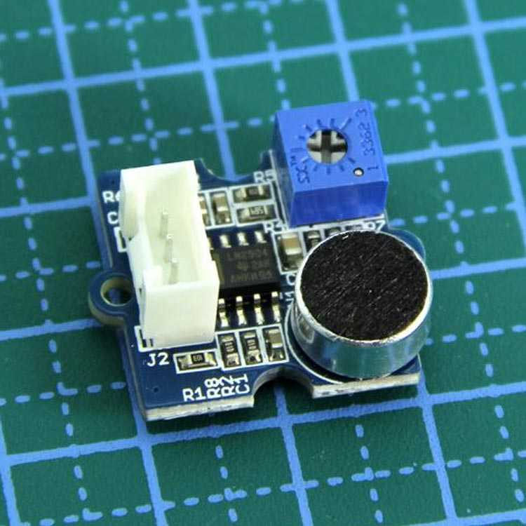
Cost – Smart Music Control System
Arduino UNO 95₺ [10]
Grove Voice Level Sensor 137 ₺ per unit – 5x to measure everywhere 685₺ [11]
Cables – Resistors Negligable
Control Software (From freelance Indian programmer) 20$ - 287₺
Total: approx. 1100₺
Figure 9: Grove Voice Level Sensor [11]

Slide 18
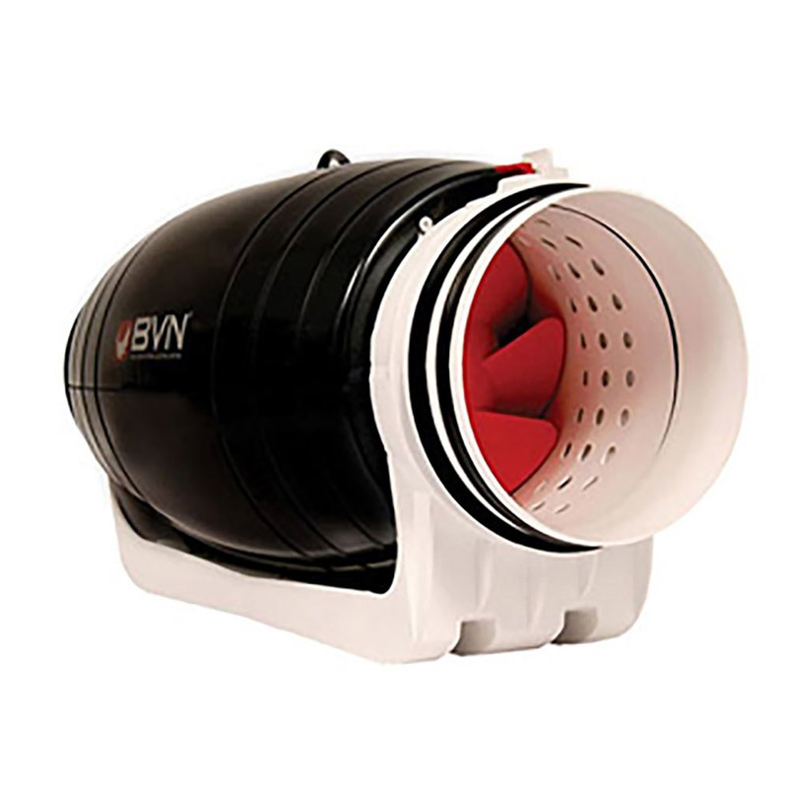
Cost – AC Units
Replace ventialtion fans with quieter and better flow rate.
Bahçıvan BMFX-SL200 [12]
Flow – 840 m^3 / h Voice Level - 35 dB
Replace 3 existing fans with this.
3 x 2460 = 7380₺
Figure 10: Bahçıvan BMFX-SL200 [12]

Slide 19
Feasibility
Wall Panels | Flooring | Smart Sound | AC Units
The architectural permittable of new wall panels
Partially Concrete walls – OK
Partially Dry Wall – Needs extra considirations
The feasibility of installing microphones around the restaurant.
Microphones are very small and light - OK
The architectural permittable of new AC units.
The Bahçıvan BMFX-SL200 is choosen with considiration of feasability.

Slide 20
Feasibility - Flooring
Carpet
Cork Flooring
Possible Option:
Vinyl Tiles
Cannot be used due to cleaning issues

Slide 21
Efficency – Wall Panels
The choosen Ege Acoustic Panels has %95 absorption rate.
8 m^2 of walls are covered.
Considering the shape of the room and how much wall is covered makes a very complex equation. Further evaluation by a sound engineer can give a approximate answer about how effective absorbtion will be.
Expected Efficency: High
Efficency – Flooring
There are Vinyl Acoustic Flooring available in market and products that claims to drop sound levels by 19 dB exists.[13]
Expected Efficency: High

Slide 22
Efficency – Smart Music Control System
Experiment 1:
11.11.21 (Saturday Night)
with one hour interval,
music is closed and customer’s noise levels response is measured for 5 minutes.
Observed average drop: 1.32 dB
Not effective

Slide 23
Efficency – AC Units
Experiment 2:
4.11.21 (Saturday Night)
with one hour interval,
AC units are closed and customer’s noise level’s response is measured for 5 minutes.
Observed average drop: 2.24dB
Not effective

Slide 24
Efficency
Wall Panels | Flooring | Smart Music | AC Units
Efficency is the most importent criteria when deciding.

Slide 25
CONCLUSION AND RECOMMENDATIONS
 | Wall Panels | Flooring | Smart Music | AC Units
Cost
Feasibility
Efficency
Conclusion:
Only installing wall panels are recomended.
Flooring needs an expert opinion on cost and efficency.
Music control and replacing AC Units, further academic research is necessary before recomending.

Slide 26
Action Plan
If Wall panels and Flooring are found applicable by experts.
 | D1 Monday | D2 | D3 | D4 | D5 Friday | D6 Saturday | D7 Sunday | D8 | D9 | D10
Expert Opinion and price research
Wall Panels Installation
Flooring Applicaton

Slide 27
Referances
[1] «NOISE INFOGRAPHIC - LEVELS BY DECIBELS» Centers of Disease Control and Prevention. [Online]. Available: https://www.cdc.gov/niosh/topics/noise/infographic- noiselevels.html. [Accessed: November 1, 2021]
[2] https://restauranttechnologynews.com/2019/09/how-sound-panels-can-reduce-restaurant-noise-levels-protect-employees-hearing-and-improve-the-guest-experience/
[3] https://www.harmoniaconsulting.co.uk/noisy-restaurants
[4] https://odeon.dk/pdf/C116-BNAM_2012_Rindel_29.pdf
[5] https://sound-zero.com/acoustic-panels-for-restaurants/
[6]https://journals.sagepub.com/doi/full/10.1177/1351010X19897232
[7] https://nymag.com/intelligencer/2020/05/that-office-ac-system-is-great-at-recirculating-viruses.html

Slide 28
[8] https://www.sciencedirect.com/topics/engineering/sound-absorption-coefficient
[9] https://urun.n11.com/studyo-ve-sahne-ekipmanlari/3cm-kalinlikta-akustik-kumas-kapli-panel-5050-cm-P503073247
[10] https://www.robotistan.com/arduino-uno-r3-klon-usb-kablo-hediyeli-usb-chip-ch340
[11] https://www.direnc.net/grove-loudness-sensor-seeedstuidio?language=tr&h=7e7a5193
[12] https://www.elektromarketim.com/bahcivan-bmfx-sl200-yuvarlak-karma-akisli-kanal-fani
[13] https://www.forbo.com/flooring/tr-tr/uruenler/heterojen-vinil/modul-up-19db-serbest-doesenebilir-vinil/bz7bzs#panel_104

